Slide 1

Disability Positive Practice:
Neurodiversity
Notes:
1
1

Slide 2

Perspectives of neurodivergent people and the diversity of their experiences
Key characteristics
Supporting neurodivergent people
Briefing Overview
Notes:
2

Slide 3
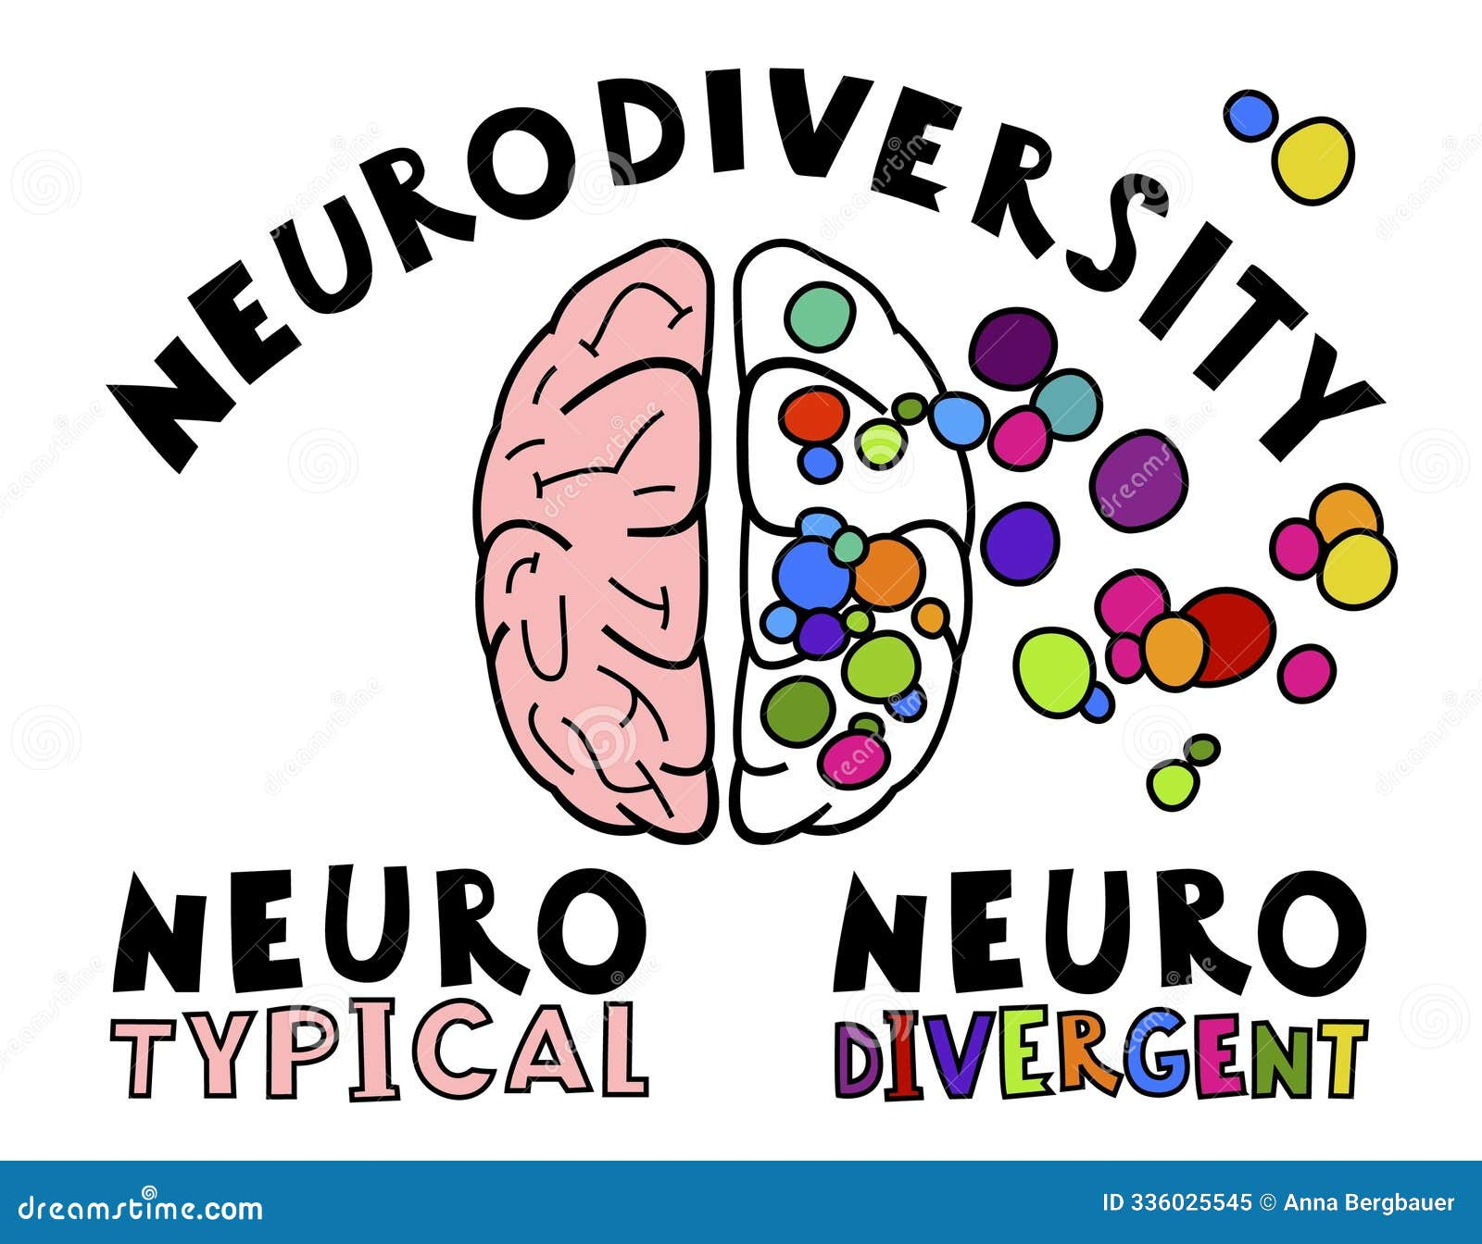
Neurodiversity refers to the concept that neurological variations, such as Dyspraxia, Dyslexia, ADHD, and Autism, among others, are natural human differences to be respected, not disorders to be cured

Slide 4

True/False
Autistic people have innate special skills
Autistic people have less empathy, than non-autistic people
Dyslexic people are exempt from learning languages in some schools
Most dyscalculic people find it difficult to learn timetables
Most dyspraxic people cannot learn to drive
ADHD people cannot focus on a single task to completion

Slide 5
Key Issues:
Identify, implement and review adjustments
Involve the neurodivergent person and other experts, e.g. psychologist
Affects the way information is learned and processed but not related to intelligence
Impact on education and learning, literacy and some workplace skills
1 in 7 people are neurodivergent

Slide 6
NeurodiversityLanguage
Identity first, e.g. autistic person, dyslexic person
Individual preference - some (minority) prefer person first, e.g. person with autism, dyslexia, dyspraxia, dyscalculia etc
An AD(H)D person/person with AD(H)D/person with VAST (Variable Attention Stimulus Trait)
Neurodivergent person
Avoid negative and medicalised language, e,g, problem, disorder, diagnosis

Slide 7

Court of Appeal Case: Peter Kelly
It is the characteristics of neurodivergence that affect a person’s day to day activities that matter, regardless of whether or not they have received an assessment
As quoted in the Court of Appeal’s judgment, ‘There is too much emphasis on attaching a label to the claimant’s condition and it is the contents of the jar, not the label, that matters.’ (ECNI)
Therefore employers should not rely on formal assessments to meet the definition of disability

Slide 8
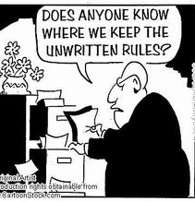
Autism:
Communication and Interaction
May not understand unwritten social rules others usually pick up, e.g., may:
Stand too close to another person
Start inappropriate subject of conversation
Appear insensitive or blunt
Speak at length about a subject of interest
Not recognise others’ feelings or social cues
Find eye contact difficult

Slide 9
May be non-speaking or minimally speaking
Understanding of abstract concepts (emotions, future, sarcasm) may be affected due to literal understanding of language
Recognising/expressing own needs can be difficult
Want to interact with others but be unsure how
Need to focus on verbal processing, so may not make eye contact or consider gestures, body language, facial expression
NB: It is important to take steps to be understanding, inclusive and welcoming
Autism:
Communication and Interaction

Slide 10
Autism:
Other effects
Over-or under-sensitive to certain sights, sounds, smells, temperature, touch or tastes
Sensitivity may vary during the day/week
Coping with change and unfamiliar situations, routine is preferred
Monotropic processing/tunnel vision e.g. hyperfocus, multi-tasking
Executive function: plan, organise, predict, time management
Demand avoidance
Video

Slide 11

Examples of supporting an autistic person in the workplace
Provide information in accessible format, e.g. written, verbal
Allowing person to see environment in advance
Questions in advance of interview, extra time, support with presentations - preparation and practice, waive test or group interview
Provide a mentor, advocate, communication support (Autism NI communication passport)
Adapt training, e.g. video off, one to-one
Allow home working/quiet area/ear defenders
Guides on e.g., photocopiers, accessing internet, coffee machine
Follow up meetings with notes
Adapt hot-desking policy as required
Enable stimming e.g. use sensory equipment, quiet room
Be flexible with uniforms

Slide 12

Macleod v Royal Berkshire NHS Foundation Trust
Dr Macleod was autistic and was employed as a Trauma and Orthopaedic Consultant
He found meetings stressful as there was frequent use of profanities and many ambiguities
He preferred to communicate by email and requested this
He experienced high levels of anxiety, especially as his requests were not accepted
Managers and colleagues did not accept his actions and perceptions were part of his autism
Some complained about his communication style when he was upset
He was continually pressurised to attend meetings

Slide 13
Macleod v Royal Berkshire NHS Foundation Trust
OH suggested adjustments:
To be explicit in giving reasons for meetings or processes
To risk assess processes before his involvement
To communicate (at least in the first instance) by email
To excuse him from attendance at the consultant (or departmental) meetings, with the claimant to participate by email if necessary

Slide 14
Macleod v Royal Berkshire NHS Foundation Trust
The organisation continued to pressurise him to attend meetings
At a meeting with his manager he was advised to improve team interactions by, e.g., offering to make a cup of tea
There was no understanding of his autism
The manager made insensitive remarks about autism, not maliciously, but due to ignorance

Slide 15
Macleod v Royal Berkshire NHS Foundation Trust
The doctor highlighted the challenges faced while working with predominantly neuro-typical colleagues
The Judge accepted that he had been “in a position of considerable distress for a number of years” prior to the meeting at which the discriminatory comment had been made
In a remedies hearing in November 2023, he received compensation of £3,000 for injury to feelings and £1,320 in interest

Slide 16
ADD/ADHD
(VAST: Variable Attention Stimulus Trait)
Key issues:
Attention control
Hyperactivity and impulsiveness
The extra ‘H’ in ADHD stands for Hyperactivity
ADHD: often described as ‘energetic, fidgety person that struggles to concentrate’
ADD: “quiet daydreamer” that can be mistaken for a shy, quiet person
NB: There is not a deficit of attention, the issue is around controlling the attention in an inaccessible environment

Slide 17
Common Traits
Speaking out of turn, blurting out responses
Enhanced stress, may lead to irritability, impatience
Taking risks, without recognising potential impact
Difficulties in relationships and social interaction, Rejection Sensitivity Dysphoria (RSD)

Slide 18

Case Study
Bronagh is a doctor
She works really well in a busy hospital environment
She attends regular meetings with management
She sometimes interrupts the discussion when she has an idea she wants to express
She is criticised for this and is told she is rude and doesn’t care about colleagues

Slide 19
She feels very upset and isolated, experiences RSD
She explains to her manager that this is associated with her ADHD – she doesn’t mean to be rude
The manager contacts Workable with Bronagh’s agreement
Expert assessment of Bronagh’s strengths and adjustment requirements
ADHD Coach suggests strategies for Bronagh and her colleagues, e.g. agenda in advance of meetings, sensitive chairing, positive communication, follow-up notes
Through the employer’s EAP, Bronagh attends CBT, to help develop personal strategies and understanding, including issues relating to RSD
ADHD Awareness for the organisation (with Bronagh’s consent)

Slide 20
What some dyslexic
people say
“I have the right ideas but can’t put them on paper”
“I can’t take in what is being said to me”
“When I read, the words jump from the page”
“I was always told I was stupid at school”
Notes:
20

Slide 21
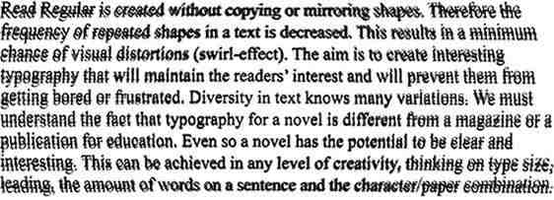
Some people see this when they read
Some people see this when they read
Notes:
21

Slide 22

Common Adjustments?
Making things multisensory: use pictures, symbols and colour
Memory aids, e.g. diaries, timers, text reminders
Allowing extra time for training, to learn skills, adjust to change, tests
Quiet room to aid concentration
Specialist software e.g. Everway (formerly TextHelp)
Coloured paper or overlays and accessible font
Questions in advance of interview, written down, extra time, support with presentations - preparation and practice

Slide 23
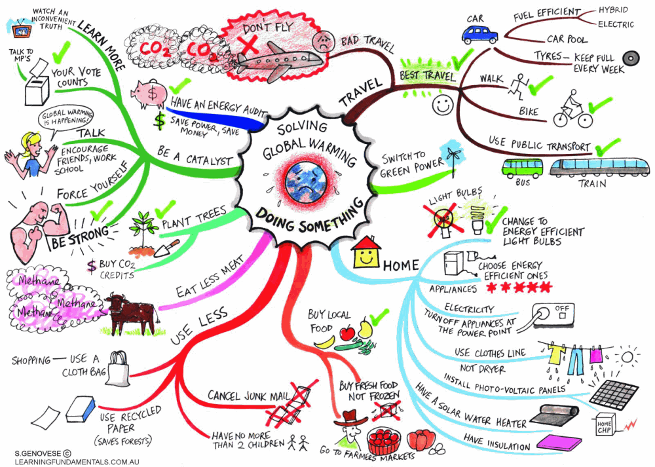

Slide 24
Case Study
Moya is dyslexic and works as a solicitor for a public body
She finds moving from case to case several times a day difficult
She has seen her boss rolls her eyes when she tries to explain her difficulties
Her boss has a dyslexic daughter and she says she has no such problems
Her confidence is very low and she feels stressed going into work every day

Slide 25
Moya attends CBT and eventually with support from a mentor and enhanced confidence, she shares her experience with HR
The organisation:
Brings in dyslexia trainers
Assesses Moya’s strengths
Assigns her to a new team where she works on an indepth, complicated case which requires continuity and focus from a key member of staff

Slide 26

Supporting Learning
Give just one instruction at a time, repeat and check understanding
Allow plenty of time, teach/instruct in small bursts with breaks
When possible, try one-to-one
Encourage use of lists and diaries so they can tick off things done
Place person where distractions are minimised
Person may need extra help, time, access to laptop
Facilitate use of memory aids

Slide 27

Key Messages
Promote an inclusive culture through:
Awareness raising
Implementing adjustments
Celebrating neurodivergent employees
People who are neurodivergent have unique skills and attributes, are an asset to the workplace when well matched to a job and supported!

Slide 28

gabrielle@efdni.org
www.efdni.org

